Slide 1
[Insert Name] Earthquake
Dialysis Facility Tabletop Exercise

Slide 2
Welcome and Introductions
Opening Remarks
  Host (or Lead Facilitator)
Introductions
  Hosting Agency/Jurisdiction
  VIPs
  Participants
  Media [if appropriate]
  Exercise Staff
  Lead Facilitator
Notes:
SLIDE DURATION: 5-8 MINUTES (not to exceed 10 MINUTES total)
EDT
Provide the Host and/or Lead Facilitator with a “Why are we here?” statement that references the exercise’s foundations in the America’s PrepareAthon! campaign, and, as appropriate, relates the day’s events to similar training/exercise activities involving whole community partners.
FACILITATOR
Offer a Welcome to all participants.
Recognize the members of the Exercise Design Team and when referencing America’s PrepareAthon!, be sure to highlight the logo on the screen.
Invite the Host and/or other senior representatives to introduce themselves, and depending on local culture/conditions, offer them the opportunity to make opening remarks.
Conclude by inviting all other participants to share their name, title and organization, as well as asking them to complete their name tents (if applicable) and encouraging them to meet/interact with one another during the breaks.

Slide 3


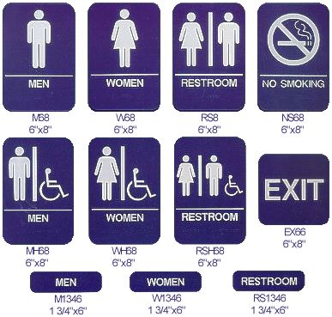



Housekeeping
Restrooms
Evacuation/Exits
Breaks/Refreshments
Use of cellphones
Other needs
Notes:
SLIDE DURATION: 1-2 MINUTES
EDT
Insert additional housekeeping items here, if necessary. Edit to reference to refreshments, as appropriate.
FACILITATOR
Review housekeeping items.

Slide 4
Exercise Goals
Test organizations plans to prepare for, respond to, and recover from an earthquake in our community.
Ensure effective coordination of plans and actions with community partners.
Strengthen relationships with our response partners.
Identify any weaknesses in our plans, consider the best way to respond to our employees’ and customers’ needs, and ensure out facility is operational as soon as possible after the event.
Notes:
SLIDE DURATION: 3-5 MINUTES
FACILITATOR
Paraphrase the Exercise Goals.
Let participants know what plans are being exercised and tested.

Slide 5
Objectives and Core Capabilities
Assess the ability to effectively manage structural maintenance considerations; earthquake-resistant construction; non-structural mitigation; back-up power and water supplies; supplies for staying on-site; accessibility considerations; and emergency repairs. [Facilities]
Assess the ability to effectively provide: employee notifications and alerts; early release/telework policies; flexible work schedules; payroll and insurance policies; employee insurance policies; employee/family reunification procedures; employees trained in first-aid with access to medical supplies; and capacity to ensure accessibility for individuals with disabilities or access and/or functional needs.[Human Resources Policies]
Notes:
SLIDE DURATION: 2-3 MINUTES
FACILITATOR
Begin by mentioning that:
The Objectives and Core Capabilities listed in this section were specifically selected by the Exercise Design Team for this event and that they are consistent with the DHS HSEEP methodology and defined within the National Preparedness Goal. Together with the scenario itself, these items provide the framework and basis for facilitated participant discussions, an evaluation of the exercise and the identification of improvement opportunities.
Finish this slide by reviewing the Objectives and associated Core Capabilities.

Slide 6
Objectives and Core Capabilities (cont.)
Assess the ability to implement plans to operate at an alternate location; access to important data; clearly defined roles and responsibilities; insurance policies; supplier and customer relationship management; and plans and processes to resume operations. [Continuity of Operations Plans]
Ability to provide critical information and updates during the emergency through multiple notification systems; guidance on how to protect critical assets; plans to provide first aid; protocols for communicating with local first responders and critical infrastructure providers; delegation of authority and secession planning; and cooperation and coordination with local, tribal, regional, state, and federal emergency preparedness officials. [Emergency Operations Plans]
Notes:
SLIDE DURATION: 1-2 MINUTES
FACILITATOR
Review the Objectives and associated Core Capabilities.

Slide 7
Objectives and Core Capabilities (cont.)
Assess the ability: to effectively track the location of on-duty staff and sheltered patients in the dialysis facilities care; a means to shelter in-place for patients, staff, and volunteers; safe evacuation of the dialysis facility; plans for arrangements with other dialysis facilities or other providers to receive patients. [Policies and Procedures]
Notes:
SLIDE DURATION: 1-2 MINUTES (if used)
.
FACILITATOR
Review the Objectives and associated Core Capabilities.

Slide 8
Participants Roles and Responsibilities
PARTICIPANT: Someone with decision-making authority (or a designated proxy), who has authority over a component of operations (e.g., Human Resources Manager). Participants should sit at the table, answer questions, and make decisions during the exercise.
OBSERVER: Someone who benefits from attending the exercise because his or her role in the organization may include implementing identified recommendations. To keep the number of speakers manageable, observers do not participate in the exercise, but are encouraged to take notes and provide feedback at the end.
NOTE-TAKER: Someone who can record the discussion during the exercise and summarize the main points as a follow-up report. You may even want to have the main points recorded on a white board. Encourage participants and observers to take notes during the exercise for the debriefing following the end of the exercise.
Notes:
SLIDE DURATION: 2-3 MINUTES
EDT
Edit the description of the Observer role to align with exercise requirements. Prior to the start of the TTX, provide clear guidance to the Facilitator regarding the roles and responsibilities of Observers:
Depending on the circumstances, Observers may include staff who serve as alternates and/or advisors to those acting as players during the exercise. In that case, such Observers may be expected to support players in developing responses.
Additionally, sometimes the Facilitator may be expected to bring the Observers’ perspective into the discussion after the primary Players have completed a discussion point.
However, in other cases, Observers may not be expected, nor will they be allowed to interact with the players during the exercise.
FACILITATOR
Explain the roles of the exercise participants per the slide.
Clarify the role of Observers in this particular exercise.
Ask Observers and Evaluators to identify themselves.

Slide 9
Rules for Players
This is a training exercise, not a test, so let’s keep it fun and positive.
We’ve identified who is a participant and who is an observer. Observers are asked to hold all comments and questions until after the scenario, at which point we’ll open the discussion to the whole team. Please speak up if you’re unclear about your role.
A scenario will be presented followed by related questions.
All participants’ thoughts and ideas are encouraged … please speak up!
Notes:
SLIDE DURATION: 3 MINUTES
FACILITATOR
Review the Rules for Players.
SPECIAL FACILITATOR GUIDANCE
Indicate that these rules are basic guidelines to ensure that the group can accomplish the exercise goals while maintaining a productive and respectful environment during the facilitated exercise discussions.
Invite all participants to keep an open mind, be respectful of everyone’s point of view and listen while others speak.
Defuse potential concerns about discussing decisions by their agency/organization – clarify that the exercise constitutes a “safe space.”
Point out that the exercise is part of a continuous improvement process – the discussions and conversations will continue after this exercise, within and across agencies and organizations.
Remind participants that they are encouraged to think outside the box and contribute to the discussion through alternate approaches and potential improvements.
Finally, note that each participant brings relevant skills, experience and perspective to this exercise, and that by representing their agency or organization they play an important role as a member of the community’s diverse emergency response team.

Slide 10
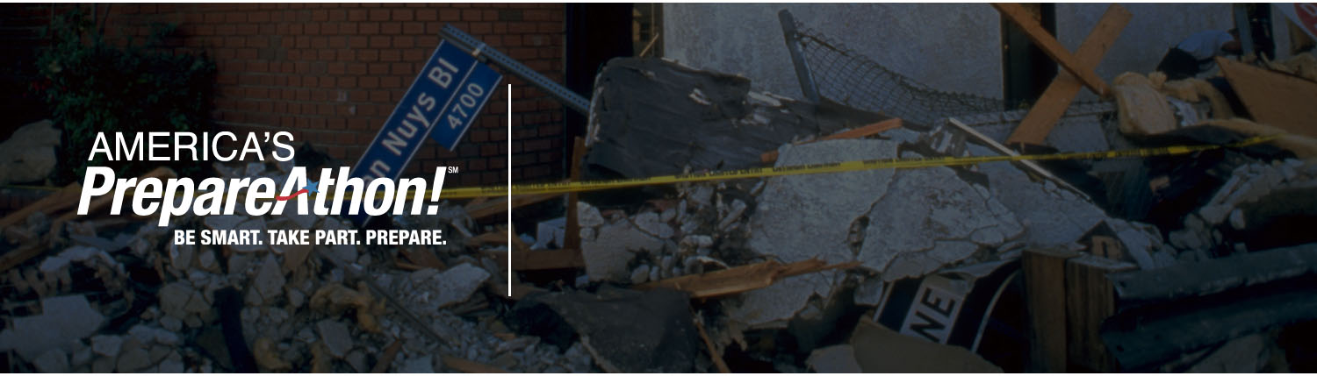
Module 1
Notes:
SLIDE DURATION: 3 MINUTES
FACILITATOR
Begin the exercise by distributing the Initial Scenario Handout to all Participants. Allow participants several minutes to read the update.
After 3 minutes, announce that you will now provide a summary highlighting key elements of the scenario update.

Slide 11
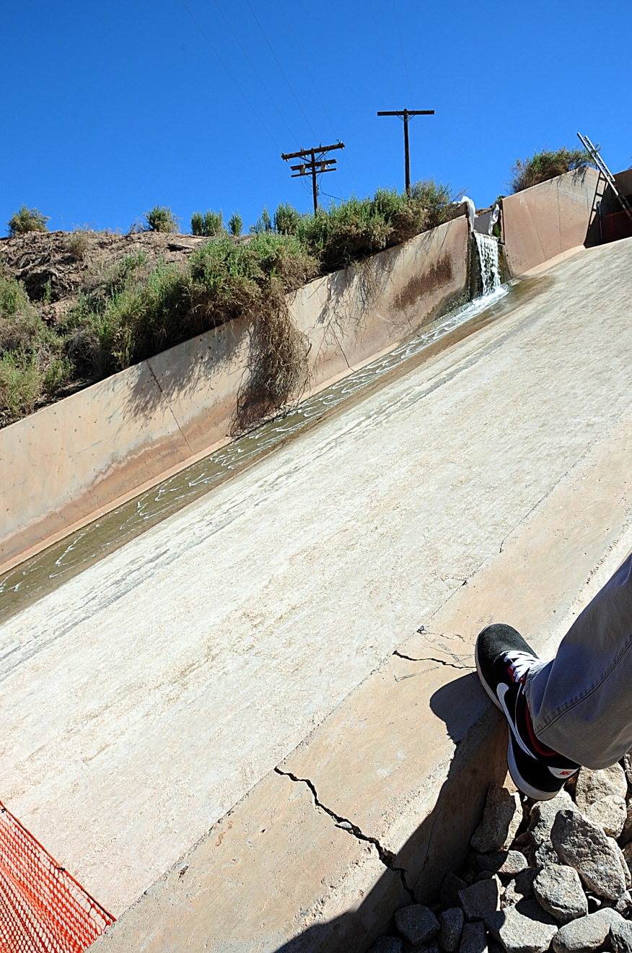
Initial Scenario
[1030 hours – Day 0]
Without warning, an earthquake registering 6.5 on the Richter magnitude scale occurs along the [insert name of fault line] near [insert name of town or city].
Initial reports estimate the quake was felt within a 60-mile radius around the epicenter.
The quake causes several ruptures of major highways, bridges, and overpasses.
Up to 60% of residents are without power.
Notes:
SLIDE DURATION: 1-2 MINUTES
EDT
Replace placeholder graphic with local image from file in the region.
FACILITATOR
Begin with a statement along the style of,
“Assume that it is a regular weekday in our community.”
Provide a paraphrase of the Scenario Background.

Slide 12
Initial Scenario (cont.)
Across the area, utilities, homes, schools, hospitals, and other buildings sustain structural damage, with leaving some people trapped in the debris. The building damage causes hundreds of injuries and leaves thousands of people without homes.
At 1128, a magnitude 4.5 aftershock occurs 7 seven miles north of [insert name of town or city].
Notes:
SLIDE DURATION: 1-2 MINUTES
FACILITATOR
Paraphrase the Initial Scenario.

Slide 13
OPTIONAL: Local Photos
[Insert local photos of earthquake damage and/or local maps.]
Notes:
[Insert local photos of earthquake damage and/or local maps.]
DELETE Slide if no picture is used

Slide 14
Gather Information
Key Themes:
Employee safety and accountability
Employee notification and communication plan
Assessing potentially affected operational components
Decision-making and decision makers
Notes:
SLIDE DURATION: 2-3 MINUTES
EDT
Consider inserting an existing image with a local map that depicts the extent of the earthquake’s impact as described in the Initial Scenario. To increase the realism of the exercise and assist players in visualizing the extent of the damage, you could also consider overlaying damaged areas on the local map and marking selected critical resources that have been affected.
FACILITATOR
Paraphrase the Key Issues.

Slide 15
Module 1 Discussion
What are your immediate actions and priorities in the first 10–15 minutes?
Do you have an identified place to evacuate to in the immediate aftermath of a disaster like an earthquake? How do you communicate this evacuation plan to your employees and patients?
Do you have a process in place to account for all of your employees and patients? If people cannot be located or contacted, what, if any, processes do you have to account for them?
Who is responsible for identifying and notifying family members about injured employees and patients, and potential fatalities?
Notes:
SLIDE DURATION: 10-15 MINUTES
FACILITATOR
Paraphrase the Discussion Points.
Follow prompts provided in the Facilitator Playbook.

Slide 16
Module 1: Discussion (cont.)
What information are you sharing with employees and patients? How are you communicating about the status of your operations? What agreements are in place with neighboring jurisdictions to support response operations?
If safe to do so, what critical operations/functions must be shut down before you leave the facility(ies)? Who knows how to do this?
Notes:
SLIDE DURATION: 10-15 MINUTES
FACILITATOR
Paraphrase the Discussion Points.
Follow prompts provided in the Facilitator Playbook.

Slide 17

Break
Notes:
OPTIONAL BREAK BEFORE STARTING MODULE 2
SLIDE DURATION: 10 MINUTES

Slide 18

Module 2
Notes:
SLIDE DURATION: 3 MINUTES
FACILITATOR
Distribute the Scenario Update #1 Handout to all Participants. Allow participants several minutes to read the update.
After 3 minutes, announce that you will now provide a summary highlighting key elements of the scenario update.

Slide 19
Scenario Update #1
[0800 hours—Day 1]
Search and rescue efforts are ongoing as reports of people trapped in the debris continue to be received.
Utility companies are working around the clock to restore services, but most homes and facilities lack electricity, natural gas, and water.
American Red Cross shelters open at undamaged public schools and recreation centers, where food, water, and personal items are available.
Crews from the Department of Public Works begin clearing arterial roadways.
Law enforcement is managing checkpoints at the most heavily damaged areas.
Notes:
SLIDE DURATION: 1-2 MINUTES
FACILITATOR
Paraphrase the Scenario Update.
Be sure to note the time jump – several hours have passed since the previous slide – and that this is a snapshot in the early hours of Day 1.

Slide 20
Take Action
Key Themes:
The next 12–24 hours: decision-making and decision makers
Employee notifications and communications
Initial damage assessment
Notes:
SLIDE DURATION: 2-3 MINUTES
FACILITATOR
Paraphrase the Key Issues.

Slide 21
Module 2 Discussion
What are your organization’s priorities over the next 12 to 24 hours?
Is your organization continuing to operate in any capacity?
Is your organization prepared to manage extensive earthquake damage? What steps would you take at this time to address the damage?
Notes:
SLIDE DURATION: 10-15 MINUTES
FACILITATOR
Paraphrase the Discussion Points.
Follow prompts provided in the Facilitator Playbook.

Slide 22

Module 3
Notes:
SLIDE DURATION: 3 MINUTES
FACILITATOR
Distribute the Scenario Update #2 Handout to all Participants. Allow participants several minutes to read the update.
After 3 minutes, announce that you will now provide a summary highlighting key elements of the scenario update.

Slide 23
Scenario Update #2
[0800 hours–Day 5]
Four mobile Disaster Recovery Centers (DRCs) are open.
More than 6,500 homes and businesses have suffered moderate to major damage.
  Approximately [5,000] families are displaced from households and almost as many require temporary shelter.
  Approximately [16,500] households are still without potable water, and [25,250] are still without power.
Parts of highways and dozens of bridges and overpasses require major repairs and debris removal.
  Approximately [30,000] truckloads will be required to remove [450,000] tons of debris.
Notes:
SLIDE DURATION: 2-3 MINUTES
FACILITATOR
Paraphrase the Scenario Update.
Be sure to note the time jump – several days have passed since end of Scenario Update #1 – and that this is a snapshot on Day 5.

Slide 24
Scenario Update #2
Most schools and public buildings remain closed at this time.
You are able to access your facility(ies) for an initial damage assessment.
There is significant damage to the structure of the building(s), and based on the initial inspection, your facility will not be operational in any capacity for at least three months.
Notes:
SLIDE DURATION: 2-3 MINUTES
FACILITATOR
Paraphrase the Scenario Update.
Be sure to note the time jump – several weeks have passed since end of Scenario Update #1 – and that this is a snapshot on Day 60.

Slide 25
Recover
Key Themes:
Continuity of operations; back-up systems
Critical operations
Property damage
Employee communications
Employee work status and key personnel
Critical community services
Vital business documents
Community support
Notes:
SLIDE DURATION: 2-3 MINUTES
FACILITATOR
Paraphrase the Key Issues.

Slide 26
Module 3: Discussion
Now that you know the extent of the damage to your facility(ies), do you have options that allow you to continue operations?
Can you access copies of your vital documents, such as insurance papers, financial information, patient records, and other key business documents?
How are you communicating with employees and volunteers regarding their work status? What are your expectations for employees and volunteers who cannot work, either because your organization is not operational or because they have suffered personal losses?
Notes:
SLIDE DURATION: 5-10 MINUTES
FACILITATOR
Paraphrase the Discussion Points.
SPECIAL FACILITATOR GUIDANCE
This discussion in this Module is designed to create a vision for rebuilding and recovery over the long-term.
Critical thinking is essential to generating a successful discussion, and by extension, a successful vision.
Do not rush participants.
Let them think about what it would look like to organize and manage the recovery process.

Slide 27
Module 3: Discussion (cont.)
What critical services do your employees and volunteers rely upon to be at work (e.g., power, transit, schools/day care)?
Experiencing disasters can be upsetting, so it is important to pay attention to the emotional reactions of your employees, volunteers, and patients. How is your organization prepared to support individuals who express anxiety or stress?
What is the long-term impact of this earthquake on your [facility/organization]? Are there any steps you can take now that may lessen the impact of any event like this in the future?
What can you do to support the community as it recovers? How can you improve your network and relationships to be better connected to the community to prepare for future events?
Notes:
SLIDE DURATION: 5-10 MINUTES
FACILITATOR
Paraphrase the Discussion Points.
SPECIAL FACILITATOR GUIDANCE
This discussion in this Module is designed to create a vision for rebuilding and recovery over the long-term.
Critical thinking is essential to generating a successful discussion, and by extension, a successful vision.
Do not rush participants.
Let them think about what it would look like to organize and manage the recovery process.

Slide 28
Break
Notes:
SLIDE DURATION: 5-10 MINUTES

Slide 29
Hot Wash Discussion
Ask both Participants and Observers to help identify organizational strengths and weaknesses, priorities, and ideas to make improvements.
Suggested prompts:
  What weaknesses in your organization’s emergency plans did this exercise expose?
  What unanticipated issues arose during the exercise?
  What gaps were identified?
  What are the high-priority issues that should be addressed?
  What are new ideas and recommendations for improvement?
  Were the exercise objectives met?
Notes:
SLIDE DURATION: 20-30 MINUTES
FACILITATOR
It is recommended that you begin with this statement,
“Thank you for your participation today. Let us take a few minutes to talk about the exercise and what we learned today as well as what we can do for the future. These results will be included in our formal After Action Report (AAR) which will be made available to everyone who participated in and observed the exercise today. I would now like to start by opening the floor to the Observers for their thoughts, comments and questions on the exercise?”
Following the Observers, invite all of the participants to share their responses to the questions listed on the slide.
Conclude by asking for any remaining comments and then thank everyone for participating in this whole community exercise.
SPECIAL FACILITATOR GUIDANCE
Ensure the note-taker/scribe takes very detailed notes during this section.
Direct him/her to capture both the comments, as well as the name and affiliation of the speakers. This information can be of value should you need to follow-up with a participant at a later date.
Regarding the “Next Steps/Follow-Up Actions” questions, be sure to identify and record specific owners for each action and a suggested timeframe for execution.

Slide 30
Closing Comments
Notes:
SLIDE DURATION: 3 MINUTES
End the session by thanking everyone for their participation and their honest feedback. Explain leadership’s commitment to using the exercise as a building block to greater organizational safety and resilience, and explain that the next steps will be a written summary of the exercise discussion, to be circulated for additional comments, and a plan to address identified areas for improvement. Give a targeted timeline to sustain the momentum. Congratulations on taking this important step towards greater resilience and improved operations!

